Slide 1
Parallel Training Methods for Neural Networks
Presented by Brett Duncan

Slide 2
Outline
Introduction
Parallel Training Methods
Batch Training
Training on GPU
Map Reduce
Future Work

Slide 3
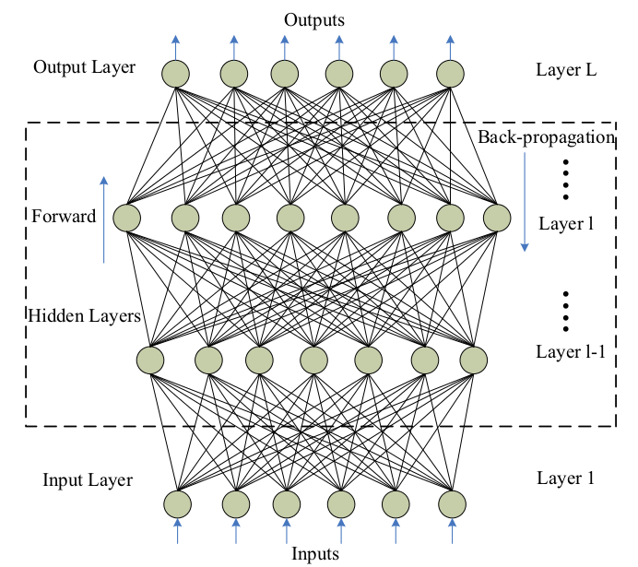

Introduction
Feedforward neural networks have input layers, hidden layers, and output layers.
Common training algorithm is backpropagation.
The training phase of neural networks is the most computationally intensive.
Hidden Layer
Inputs
$$w_{ij}$$
Output
Notes:
A common training algorithm is back propagation.
First, a training pattern will be input into the input layer, and each layer performs calculations using the weights and some function. An output is produced through this forward propagation.
Next is the back propagation, in which the deltas (errors) are calculated of the output and hidden neurons.
Then the weights are updated using gradient descent to minimize the error.
In feed-forward phase, input portion of a training pattern is fed to input layer of the network. It is propagated through layers to compute activation values of nodes in each layer. The difference between activation values of nodes in output layer
and expected output value (output part of the training pattern) defines the error in the output layer.
In back-propagation of error phase, the error in output layer is propagated to nodes in the layers below it to compute the error associated with each
neuron in the layers below.
The third phase updates weights based upon the new error and activation values.

Slide 4
Batch Training
Batch training updates neurons' weights and thresholds at the end of each training epoch (after processing of all training patterns) [1].
Notes:
Usually, in the sequential algorithm, weights and thresholds are updated after processing each pattern in a training set.

Slide 5
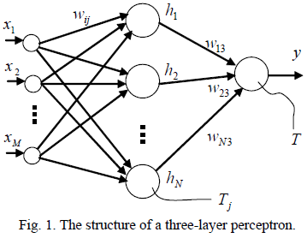
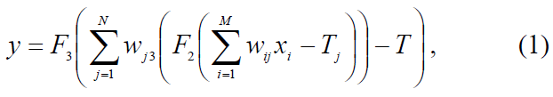
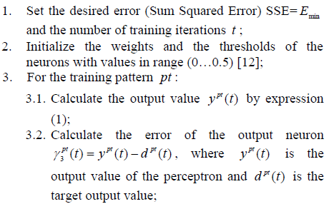
Batch Training
This is the sequential version.

Slide 6
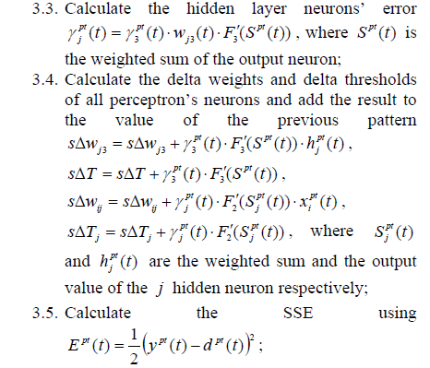
Batch Training

Slide 7
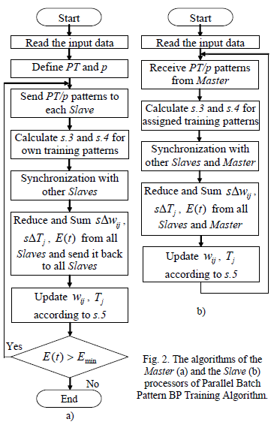
Batch Training
Master/worker implementation
Step 3 is parallelized
PT is the number of patterns
p is the number of processors

Slide 8
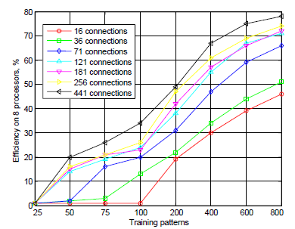
Batch Training
Parallelization efficiency on 8 processors of NEC TX-7 supercomputer.
Number of training patterns should be 100+ for efficient parallelization.

Slide 9
Training on GPU
Both neural networks and GPUs contain many simple computing units.
Could map each node to a GPU thread, but non-input layers depend on neighboring layers.
One techniques is to use a kernel for each layer [2].
Notes:
each layer separately, in the required order, but operating on
all available input cases at the same time, in parallel. The
paralellism occurs between different input cases and on the
same network layer, instead of between nodes and layers of
the whole network as in the first idea.

Slide 10
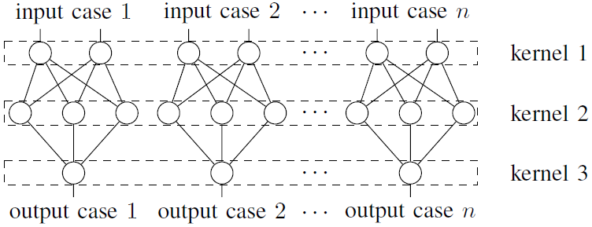
Training on GPU
Kernel for each layer
Many input cases are collected and operated on in batch.
Each layer computed separately, operating on all input cases in parallel.
Notes:
each layer separately, in the required order, but operating on
all available input cases at the same time, in parallel. The
paralellism occurs between different input cases and on the
same network layer, instead of between nodes and layers of
the whole network as in the first idea.

Slide 11
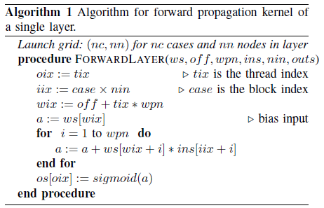
Training on GPU
Forward Propagation
Kernel for forward propagation in a layer
Inputs for first hidden layer are from the input case
Inputs for subsequent layers are outputs of preceding layer
Notes:
tix: Thread index
ws: matrix containing the network weights
off: offset into the weight matrix for the layer weights
wpn: weights per node for the layer
ins: input array for the layer
nin: number of inputs
outs: output array for the layer
The output array for a layer becomes the input array for the next layer. The forward propagation kernels will be launched for each layer until the outputs of the last layer are computed.

Slide 12

Training on GPU
Backpropagation
Kernel calculates deltas
$δ_{i}=−\left(d_{i}−y_{i}\right)a′(y_{i})$: deltas of output layer
$δ_{i}=\sum_{k}{w_{ki}δ_{k}a′(y_{i})}$: deltas of hidden layers
Kernel calculates error derivative
$\frac{∂E_{p}}{∂w_{ik}}=δ_{i}y_{k}$: error derivative
Weight update
$\frac{∂E}{∂w_{ik}}=\sum_{p}{\frac{∂E_{p}}{∂w_{ik}}}$ (reduction)
$w_{ik}^{′}=w_{ik}−η\frac{∂E}{∂w_{ik}}$ (calculated by kernel)
Notes:
Calculating Deltas: A delta value must be calculated for each neuron and each input case.
Error derivatives: The derivatives of the error function in relation to the weights are used to update the weights in order to reduce the error.
The Kernel that calculates the error derivative will compute it for weight and input case. The kernel is launched with a grid composed of a number of blocks equal to the number of input cases and number of threads per block to the number of weights in the whole network.
Weight update: The first equation is the overall derivatives for all input cases calculated as the sum of derivatives of each case.
The second value calculates the new value of the weight, which is the old value minus the derivative of the error times the learning rate, $η$.

Slide 13

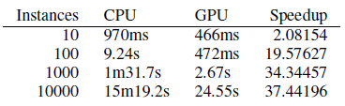
Training on GPU
Time performance for training three datasets using CPU and GPU versions of neural networks.
Time performance of input cases randomly selected from adult dataset.
Notes:
The larger the training set, the more speedup you get on the GPU.

Slide 14
Map Reduce
MapReduce based Genetic Algorithm Improved Back Propagation [3]
Genetic algorithm is first iterated a few times to find initial weights
BP algorithm is used to find appropriate weights that meet requirement

Slide 15
Map Reduce
Map Function
Input: key, value
Output: key, WeightWritable
Map (key, value) {
while (not reach the local iteration) {
Calculate the influence
}
Calculate the partial influence after local iteration
Create WeightWritable
Set WeightWritable with partial influence
Emit (key, WeightWritable)
}
Notes:
Local iteration is when updates are made on a record after a few iterations.
Influence is the error?

Slide 16
Map Reduce
Reduce Function
Input: key, value
Output: updated weights
Reduce (key, value) {
while (not all values have been processed) {
Collect all the influence of one weight
}
Update weight
Write the updated weight on HDFS
}
Notes:
HDFS (Hadoop Distributed File System)

Slide 17
Map Reduce
Genetic Algorithm based on MapReduce
Map Function
Input: key, value
Output: individual, error
Map (key, value) {
while (not all individuals have been processed) {
Calculate the next individual’s error
Emit (individual, error)
}
}
Notes:
HDFS (Hadoop Distributed File System)

Slide 18
Map Reduce
Genetic Algorithm based on MapReduce
Reduce function
Input: key, value
Output: key, new individual
Reduce (key, value) {
For each individual {
Calculate the fitness according to the error
}
Selection operation
Crossover operation
Mutation operation
Emit (key, new individual)
}
Notes:
HDFS (Hadoop Distributed File System)

Slide 19
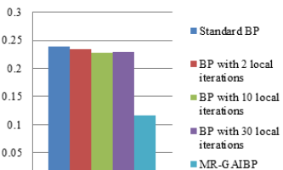
Map Reduce
Time elapsed (s) and error charts

Slide 20
Future Work
Implementing other types of neural networks on GPUs
Recurrent neural networks
Restricted Boltzmann Machines
Convolutional Neural Networks
More algorithms for cloud computing clusters

Slide 21
References
[1] Turchenko, V.; Grandinetti, L., "Efficiency Research of Batch and Single Pattern MLP Parallel Training Algorithms," IEEE International Workshop on Intelligent Data Acquisition and Advanced Computing Systems: Technology and Applications, 2009. IDAACS 2009. pp.218,224, 21-23 Sept. 2009
[2] Gurgel, S.T.A.; De A Formiga, A., "Parallel Implementation of Feedforward Neural Networks on GPUs," 2013 Brazilian Conference on Intelligent Systems (BRACIS), pp.143,149, 19-24 Oct. 2013
[3] Zhu Chenje; Rao Ruonan, "The Improved BP Algorithm Based on MapReduce and Genetic Algorithm," 2012 International Conference on Computer Science & Service System (CSSS), pp.1567,1570, 11-13 Aug. 2012

